Slide 1
Introduction to Bioinformatics
In the name of the most high
Short Read Alignment
Ali Sharifi-Zarchi
Department of Computer Engineering, Sharif University of Technology
These slides are available under the Creative Commons Attribution License.

Slide 2
Analysis Pipeline
Sample Preparation
Sequencing
Quality Control
Reference Genome Available?
Yes
No
Alignment
Assembly
Variation Detection
Peak Finding
Expression Analysis
Gap Filling
SNV, CNV, Indelds
TFBS,
Histone Codes
Expression Level DE Genes
Reference Genome

Slide 3
Aligning Short Reads to the Reference Genome

Slide 4

Possible Strategies
Hashing
Trie
Burrows Wheeler Transform

Slide 5
Trie

Slide 6
Suffix Tree

Slide 7
Burrows Wheeler Transform (BWT)
$babaabdad
aabdad$bab
abaabdad$b
abdad$baba
ad$babaabd
baabdad$ba
babaabdad$
bdad$babaa
d$babaabda
dad$babaab
babaabdad$

Slide 8
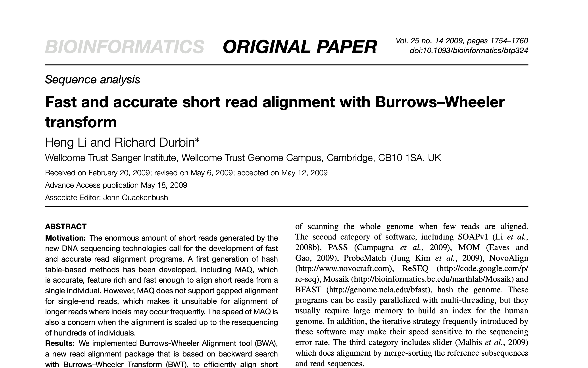
BWA

Slide 9
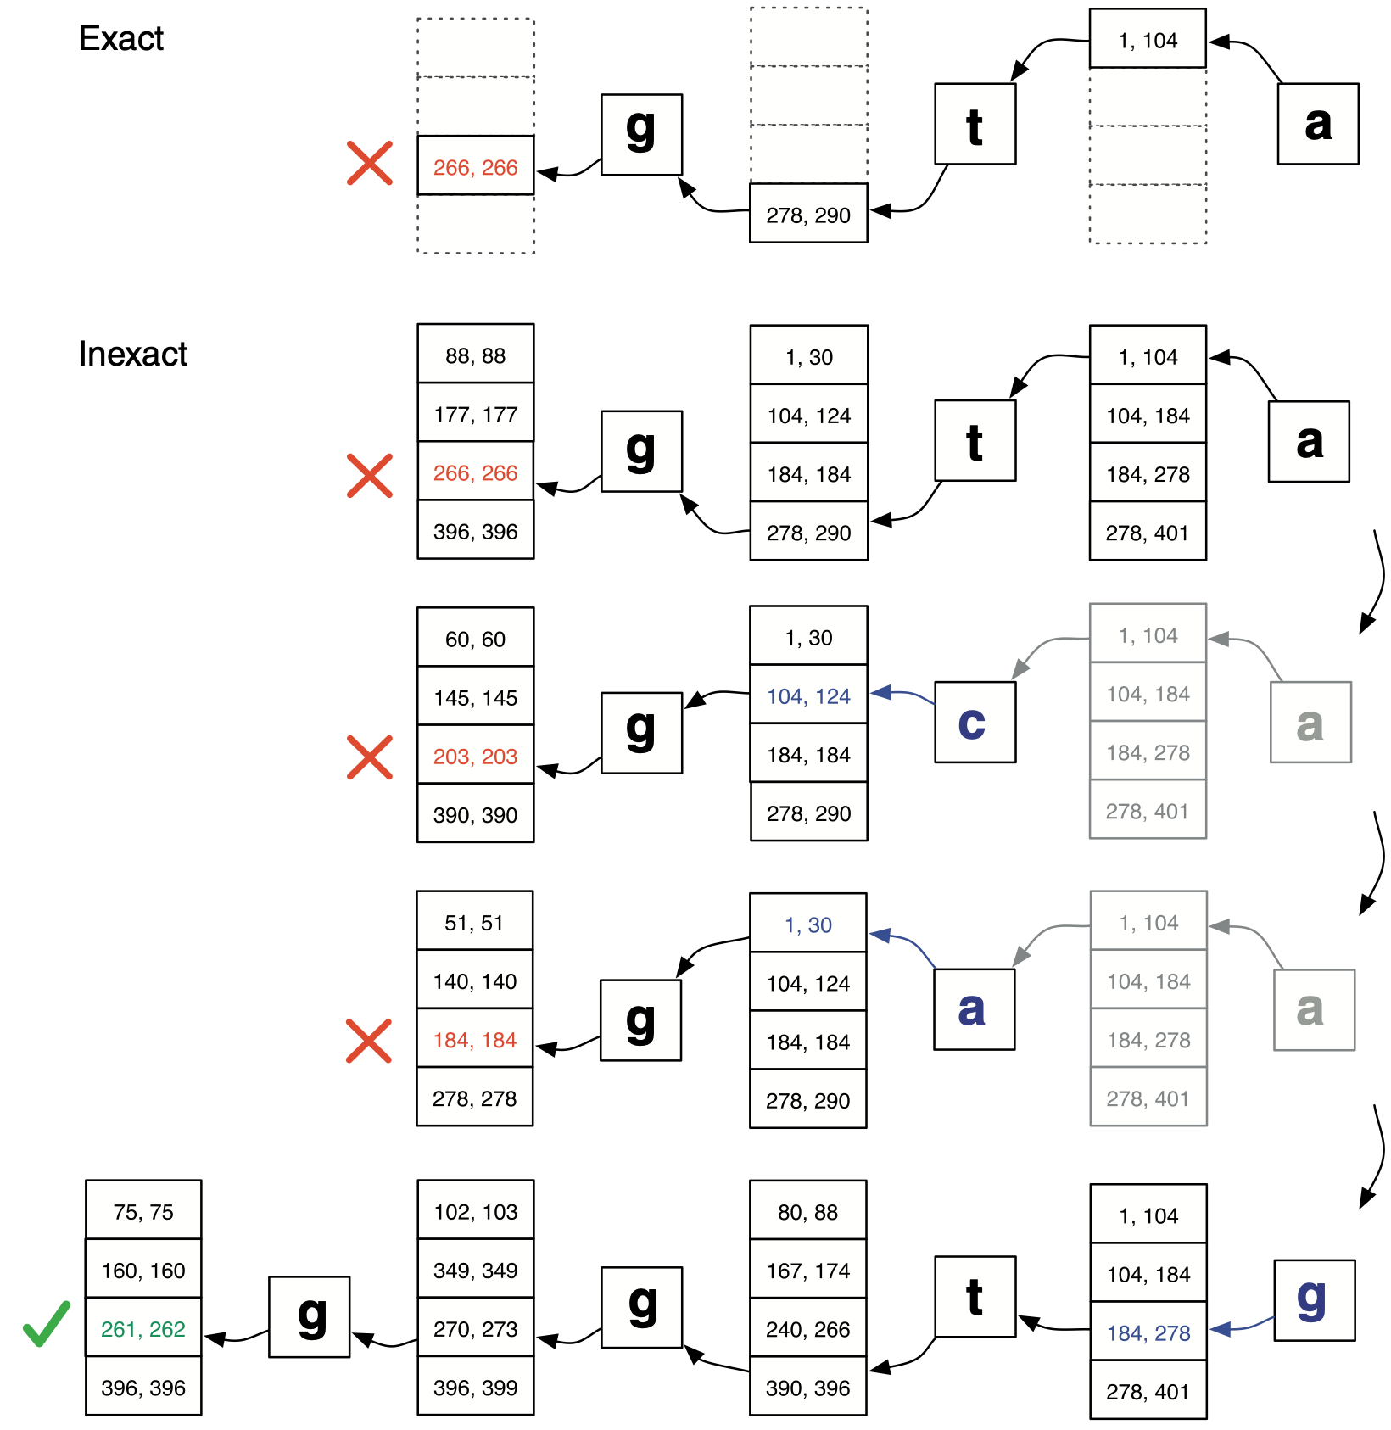
Bowtie

Slide 10
Aryana
Our short and long read aligner
The same platform aligns both gDNA and Bis-seq data
Uses BWA implementation of the Burrows-Wheeler Transform, but with completely different approach

Slide 11

Strategy
5’
3’

Slide 12
Strategy

Slide 13
Bidirectional Matching
The reverse-complement of the reference genome is concatenated at the end
Hence we can extend the seed sequence in both directions

Slide 14
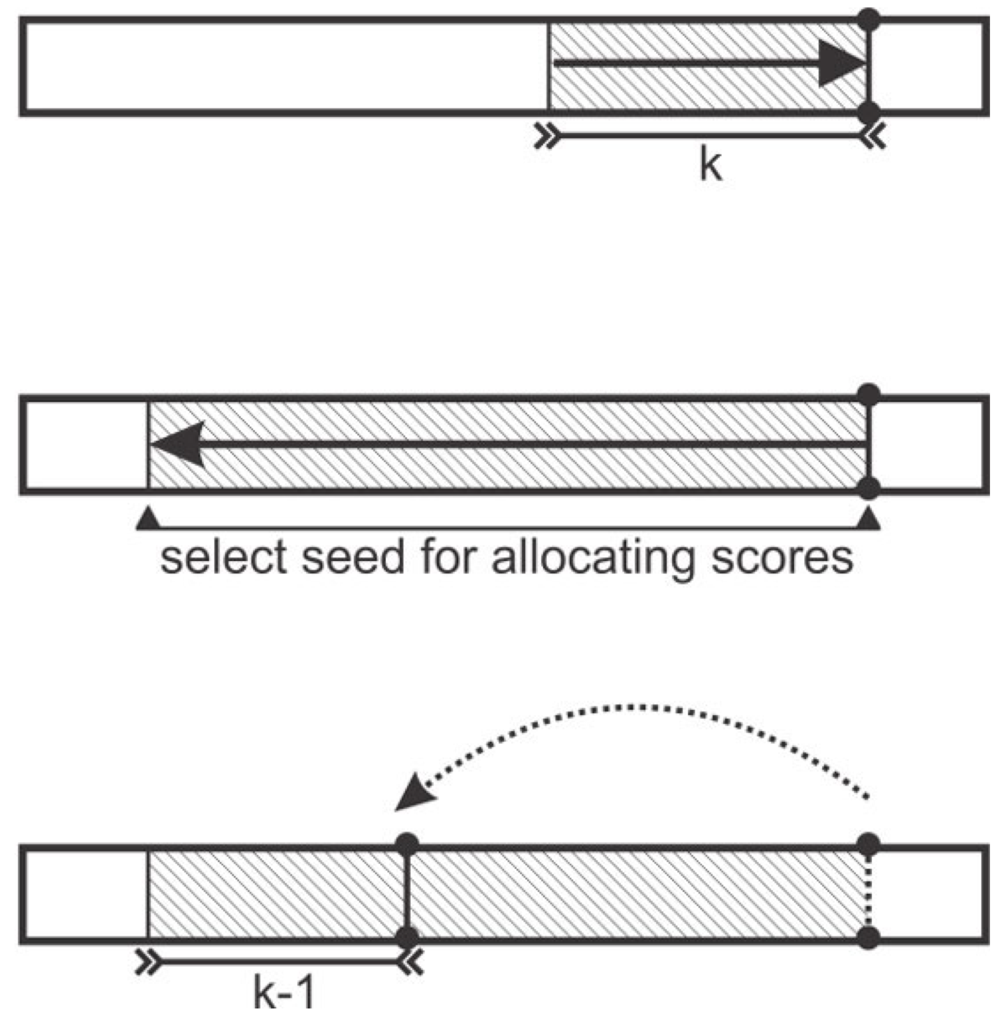
Jumping With Match

Slide 15
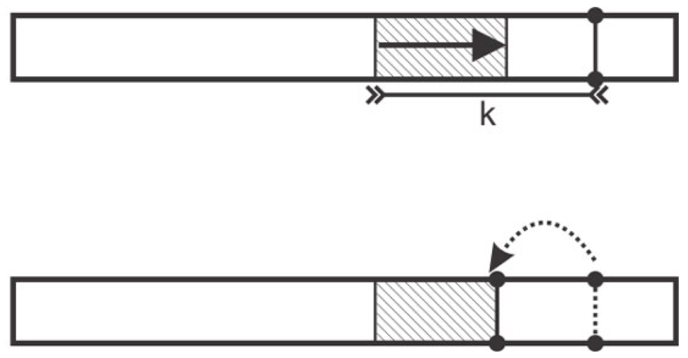
Jumping Without Match

Slide 16
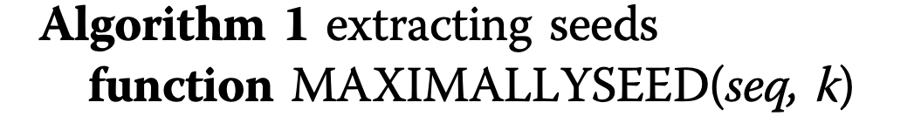

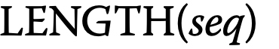
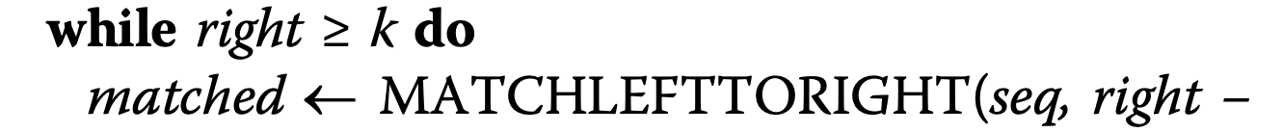

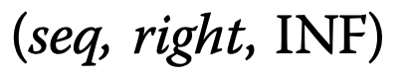
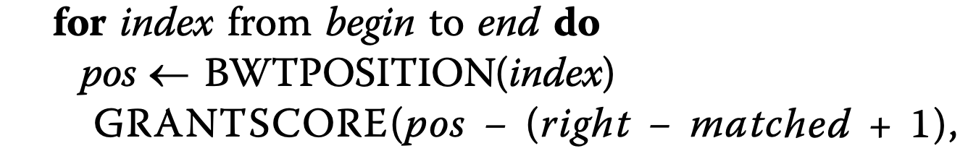

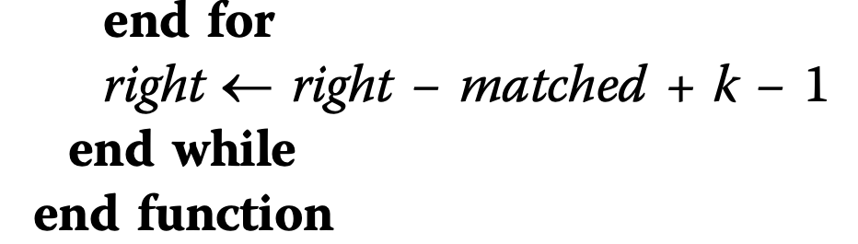
Seed Search Algorithm

Slide 17
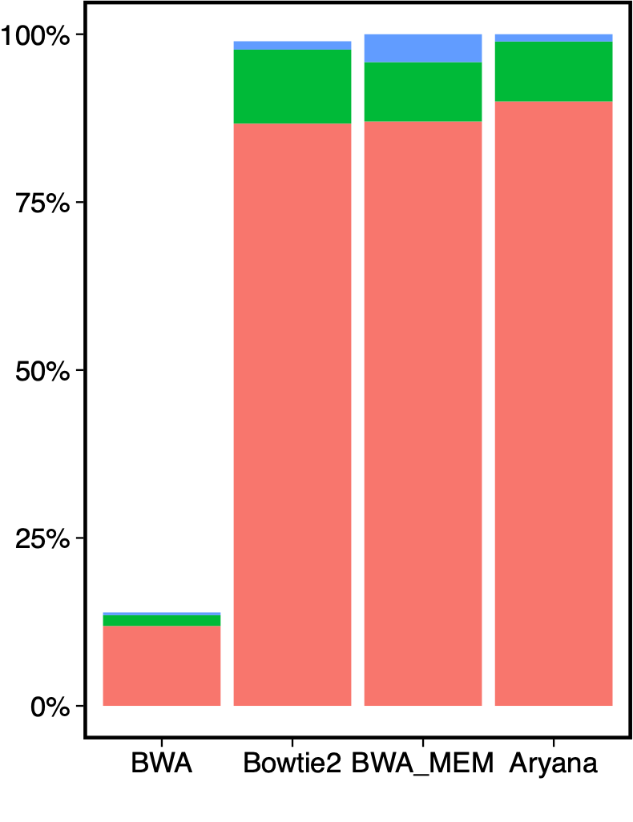
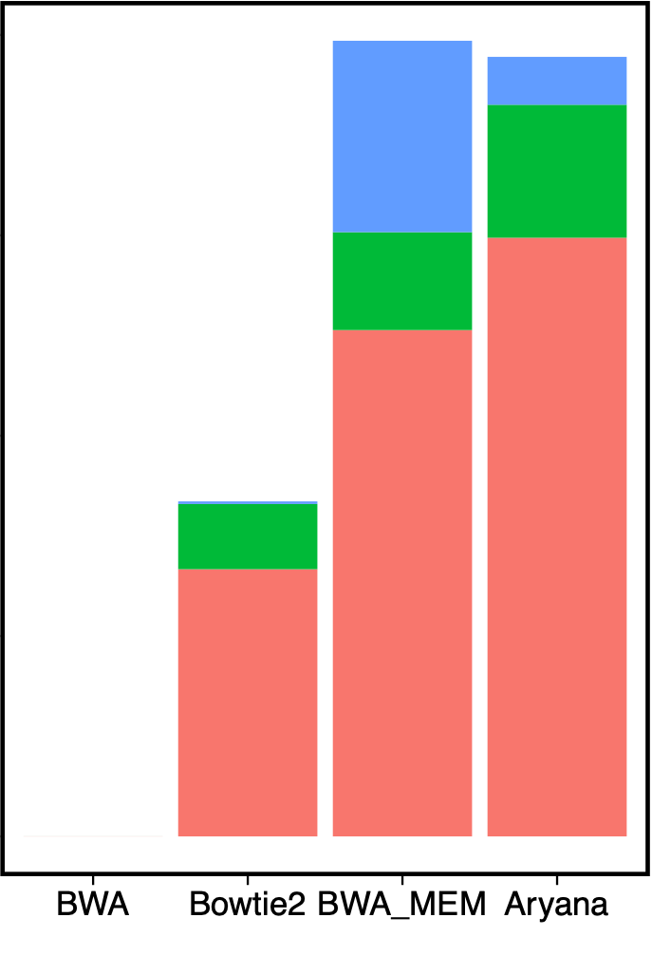
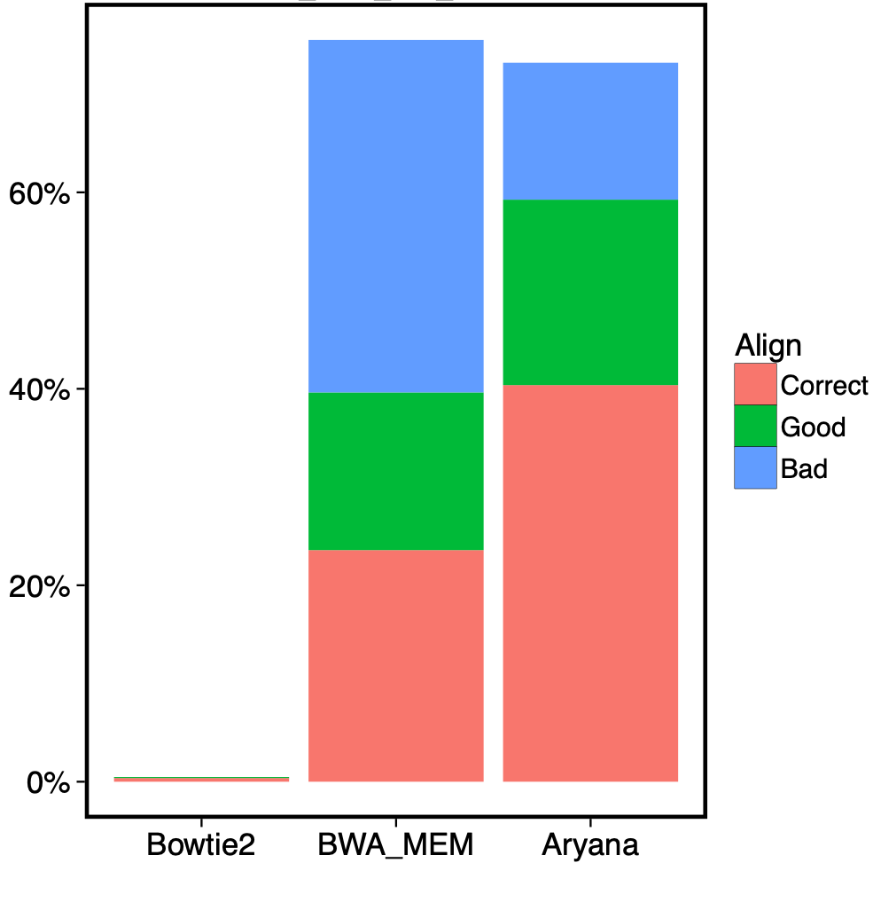
Mismatch & Indel Rates
0.01
0.03
0.05

Slide 18
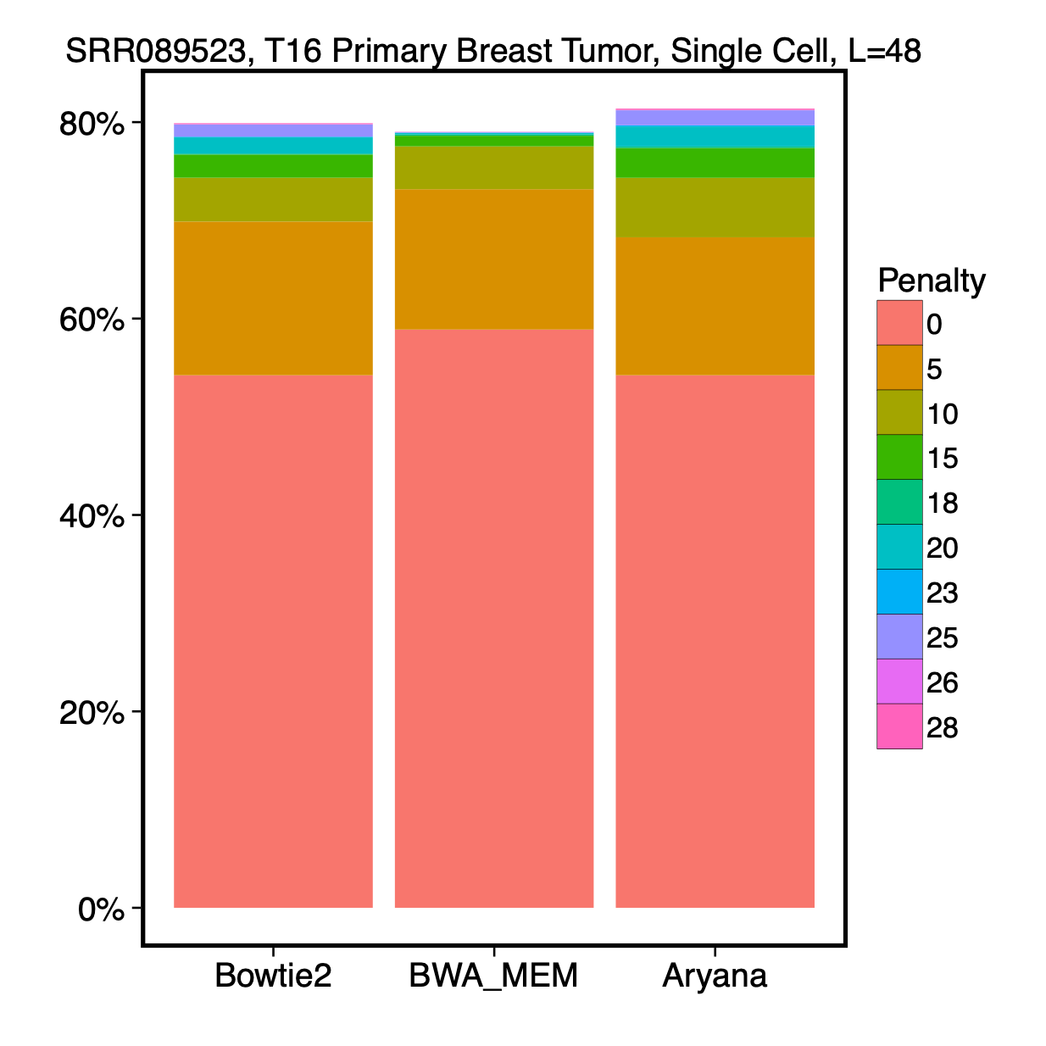
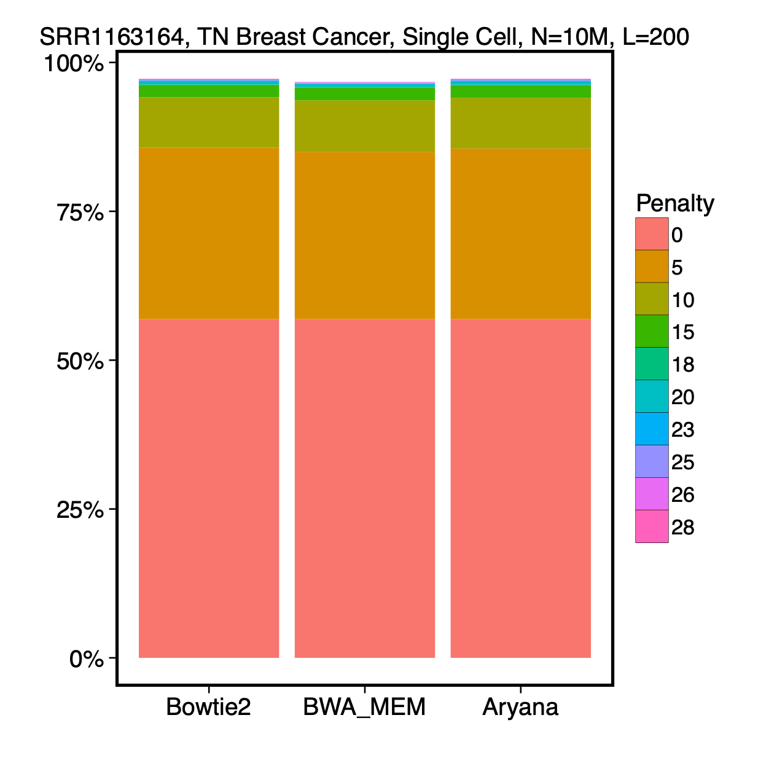
Single Cell Cancer Samples

Slide 19
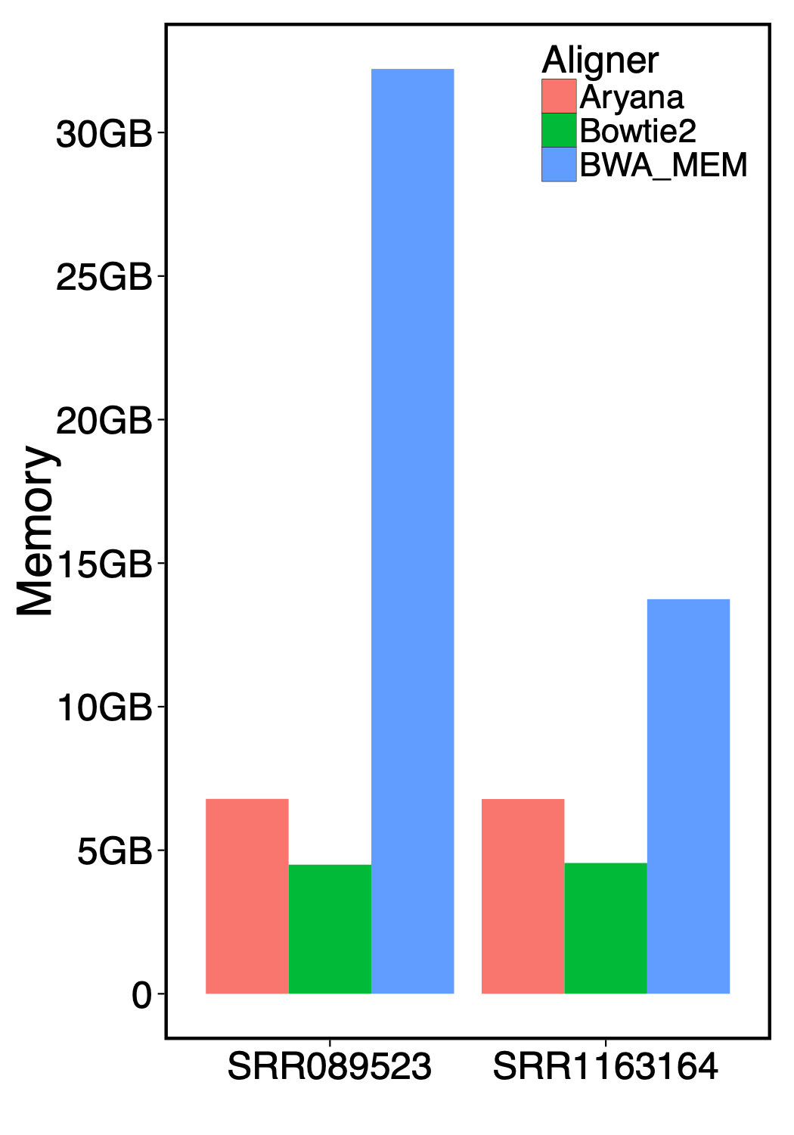
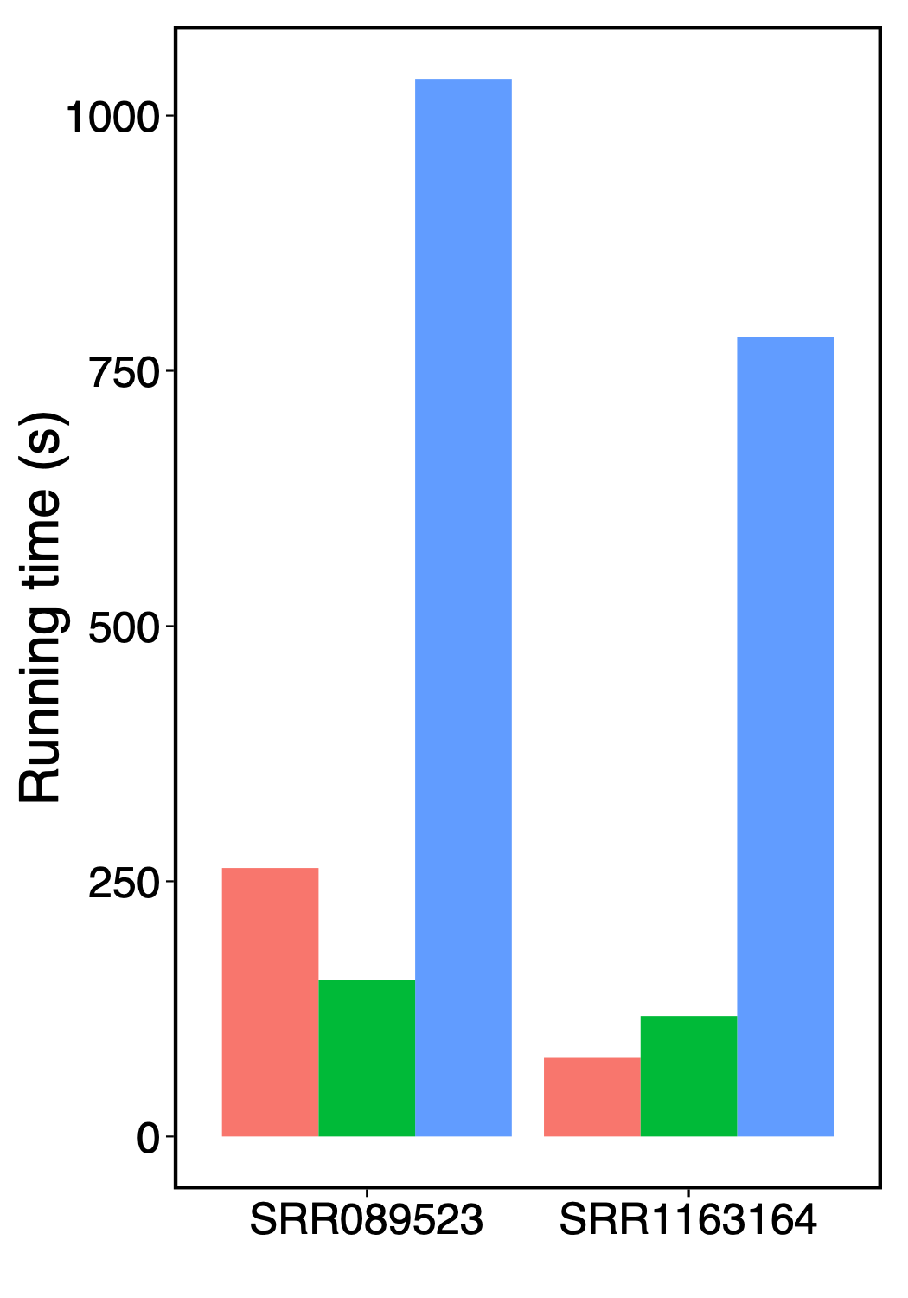
Performance Analysis

Slide 20
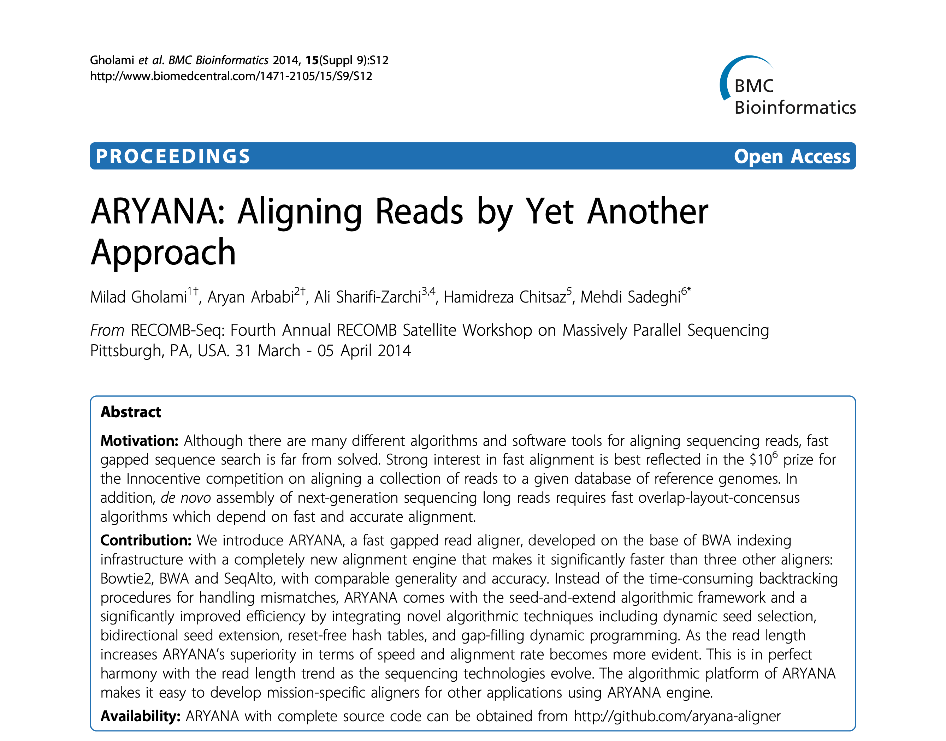

Slide 21
RNASeq Alignment

Slide 22
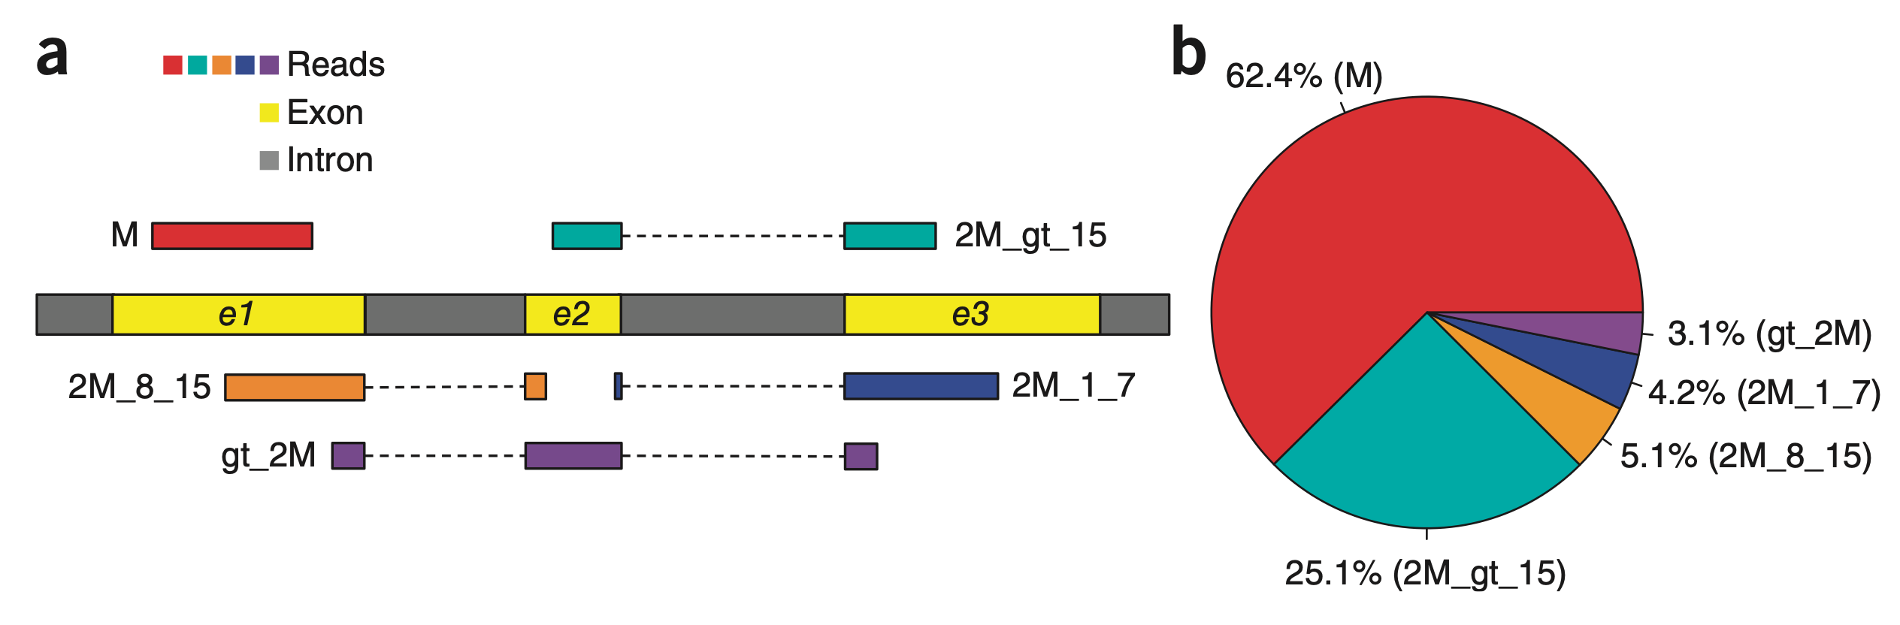
Different Types of Reads

Slide 23
HISAT Indexing Strategy
A global FM index for entire genome: Tophat, STAR, etc.
The novel idea of HISAT: small FM indexes, for 64 kbp regions that collectively cover the genome
For human genome: ~48,000 local FM indexes, each overlapping its neighbor by 1,024 bp
Overlapping boundaries: to align reads that would otherwise span two indexes

Slide 24
Implementation Details
HISAT uses the Bowtie2 implementation to construct and search an FM index
It stores large number of local indexes in a small set of files

Slide 25
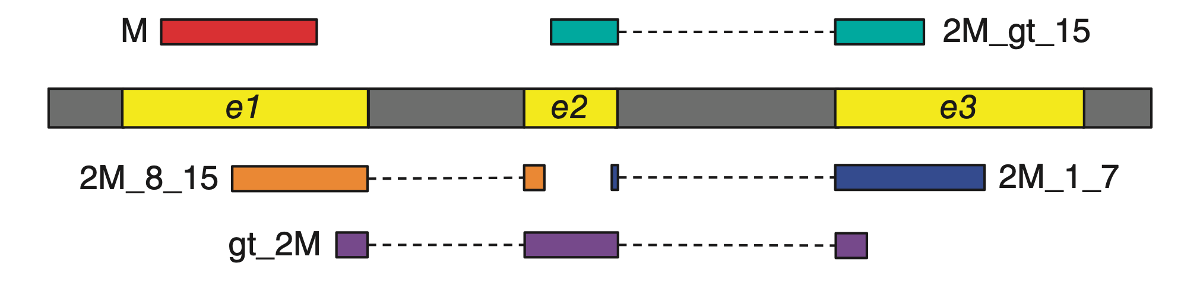
Alignment Strategies
Anchors of > 7bp: local indexes. An 8 bp anchor expected to occur ~48,000 times in human genome and once in 64 kbp region
For anchors of 1-7 bp length: Using splice-site information found by aligning other reads (HISATx2)

Slide 26
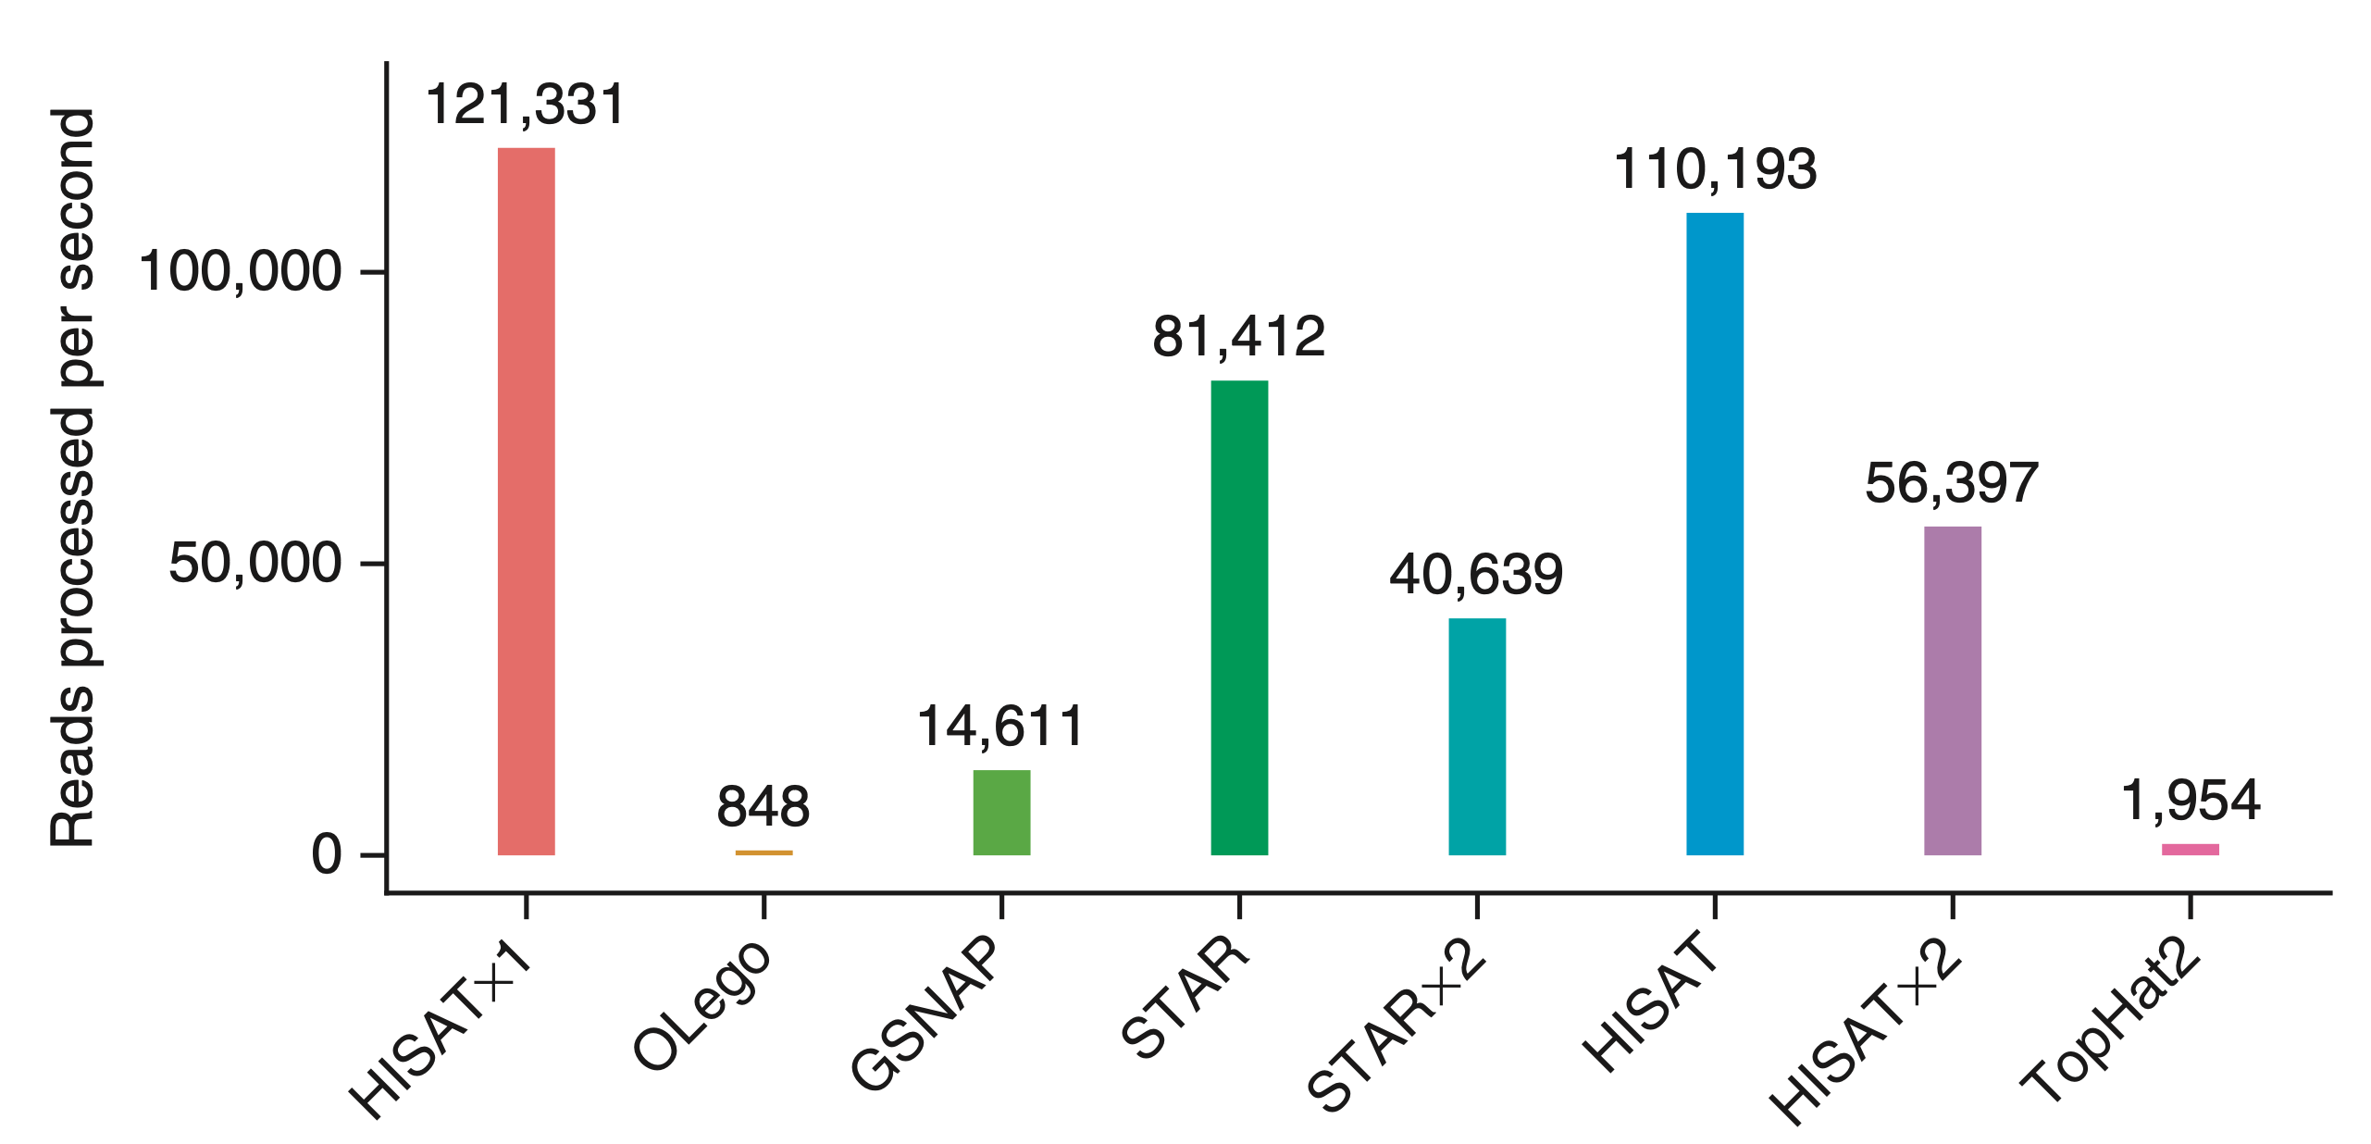
Speed Comparison
Notes:
HISATx1 uses a one-pass approach that aligns each pair of reads independently of others. HISATx2 is a two-pass version of HISAT to mimic the two-step approach used in TopHat2.

Slide 27
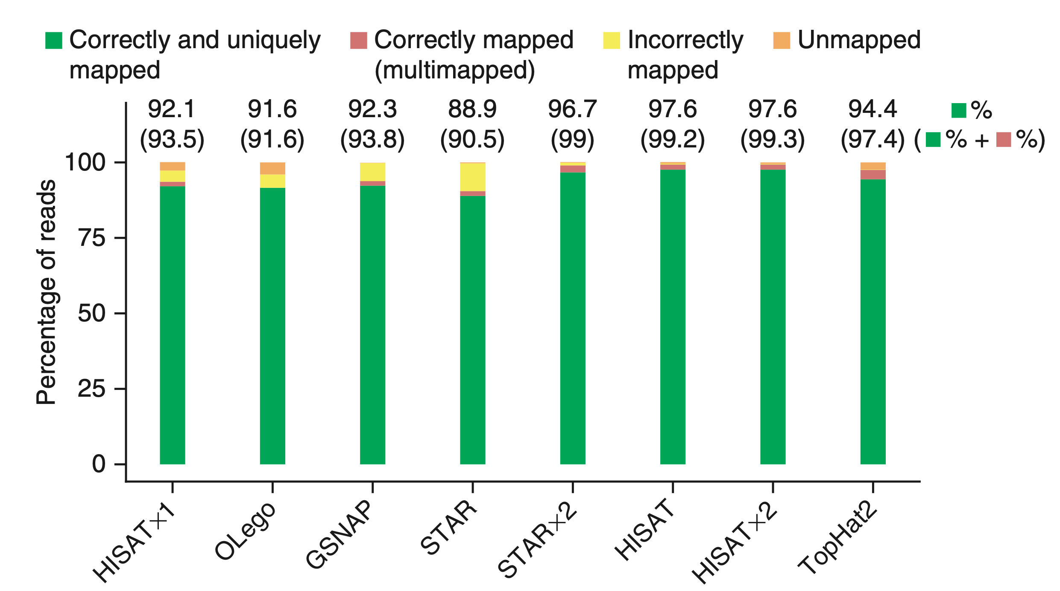
Accuracy Comparison: All Types of Reads

Slide 28
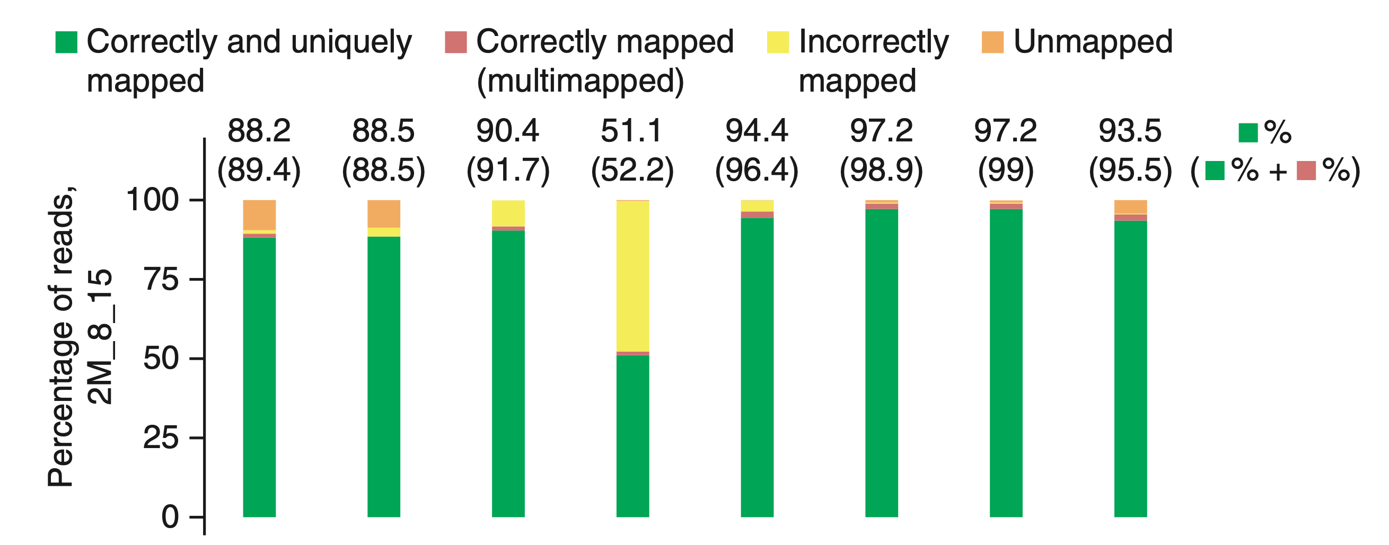
Accuracy Comparison: 8-15bp Anchors

Slide 29
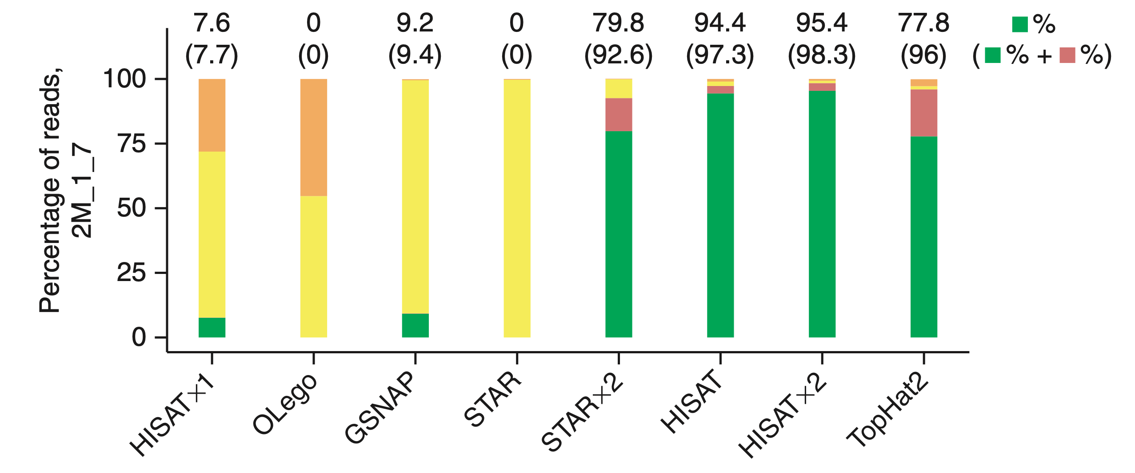
Accuracy Comparison: 1-7bp Anchors

Slide 30
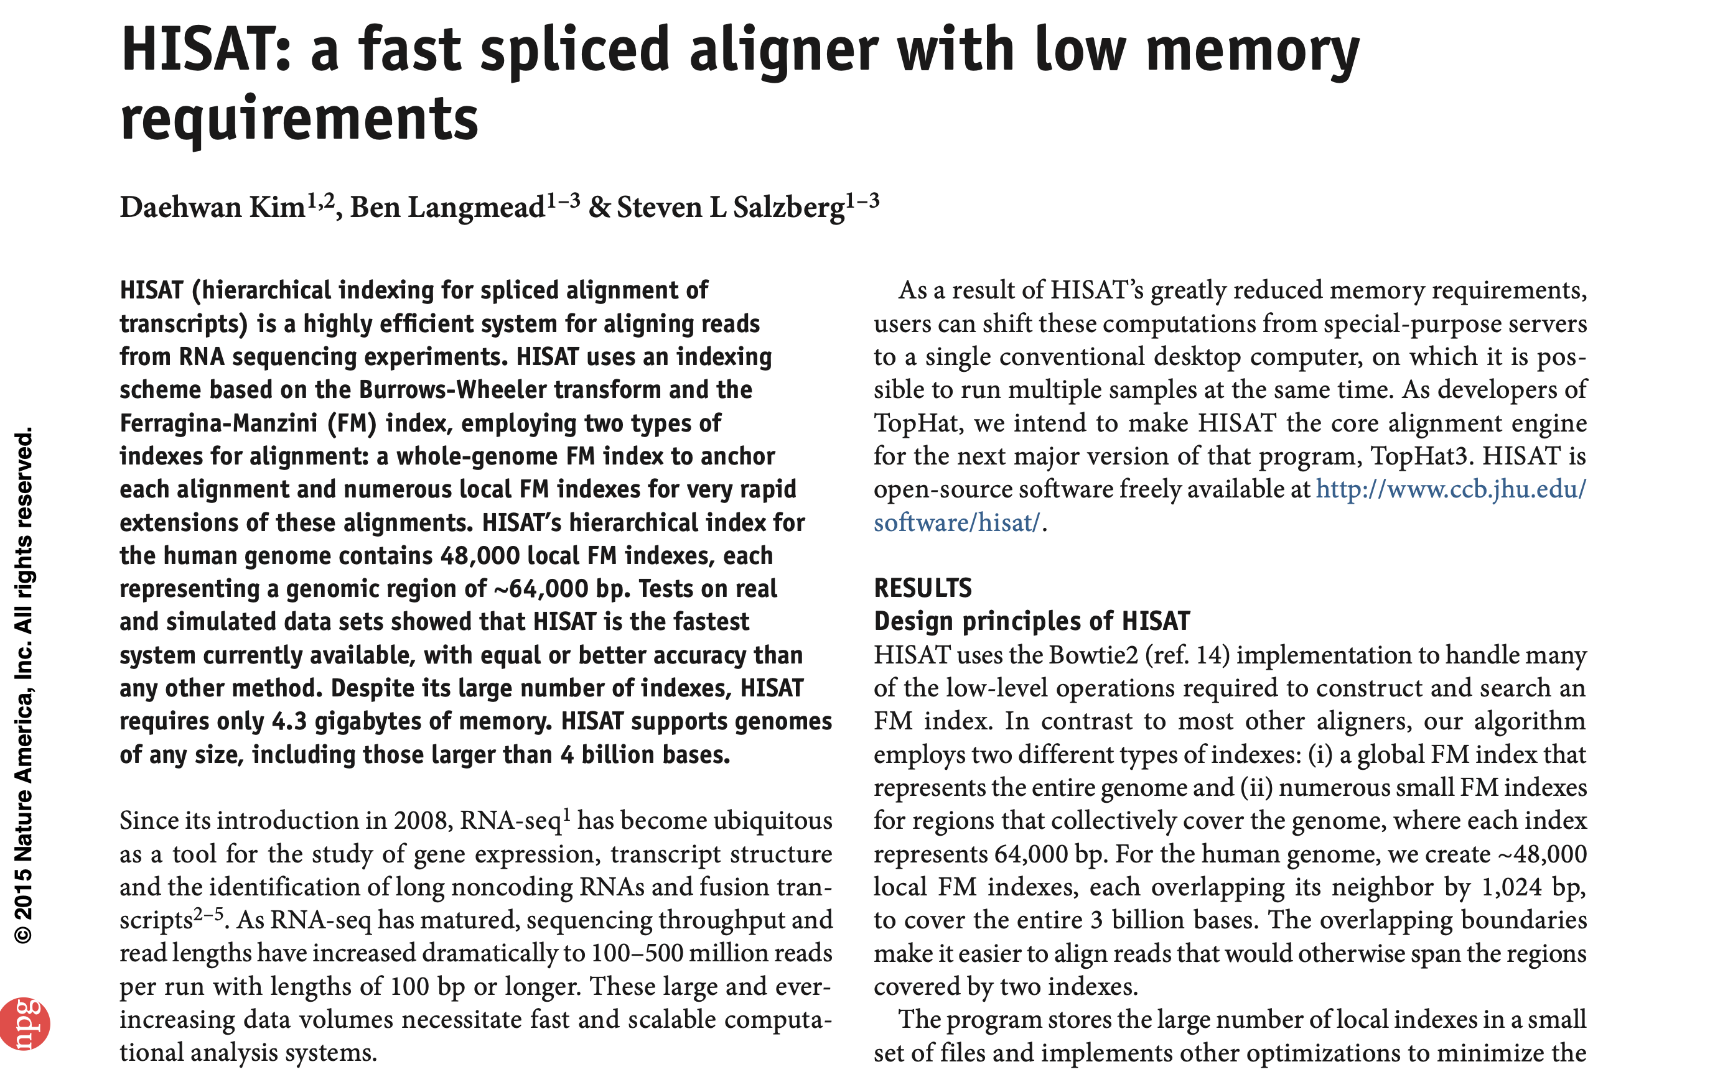

Slide 31
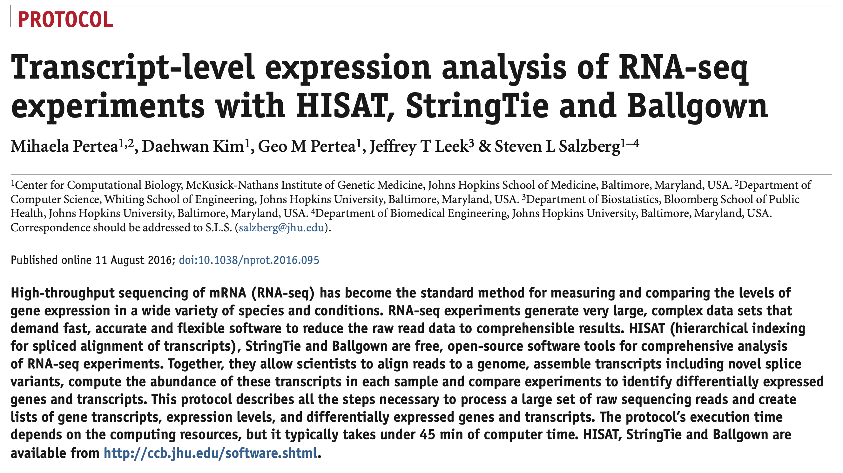

Slide 32
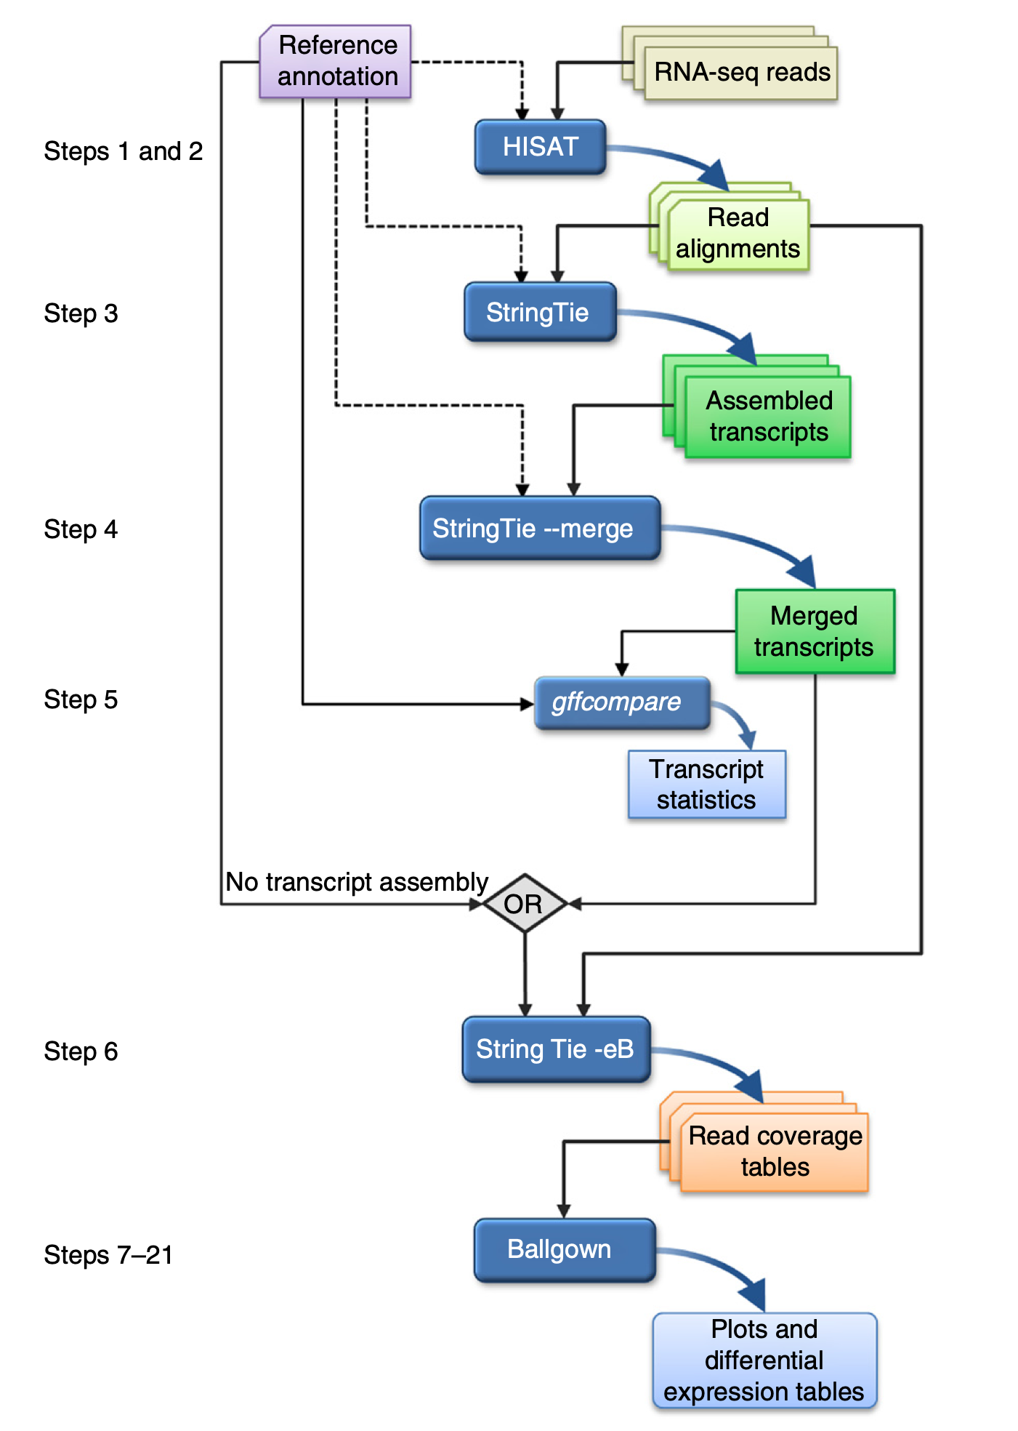

Slide 33
Bisulfite-Seq Alignment

Slide 34
DNA Methylation
The only epigenetic mark with a clearly identified mechanism of inheritance
First reported in 1925 and confirmed in 1950’s
Plays a role in many biological processes including imprinting, transcription silencing, development, differentiation and inflammation
Linked to cancer and several other diseases

Slide 35
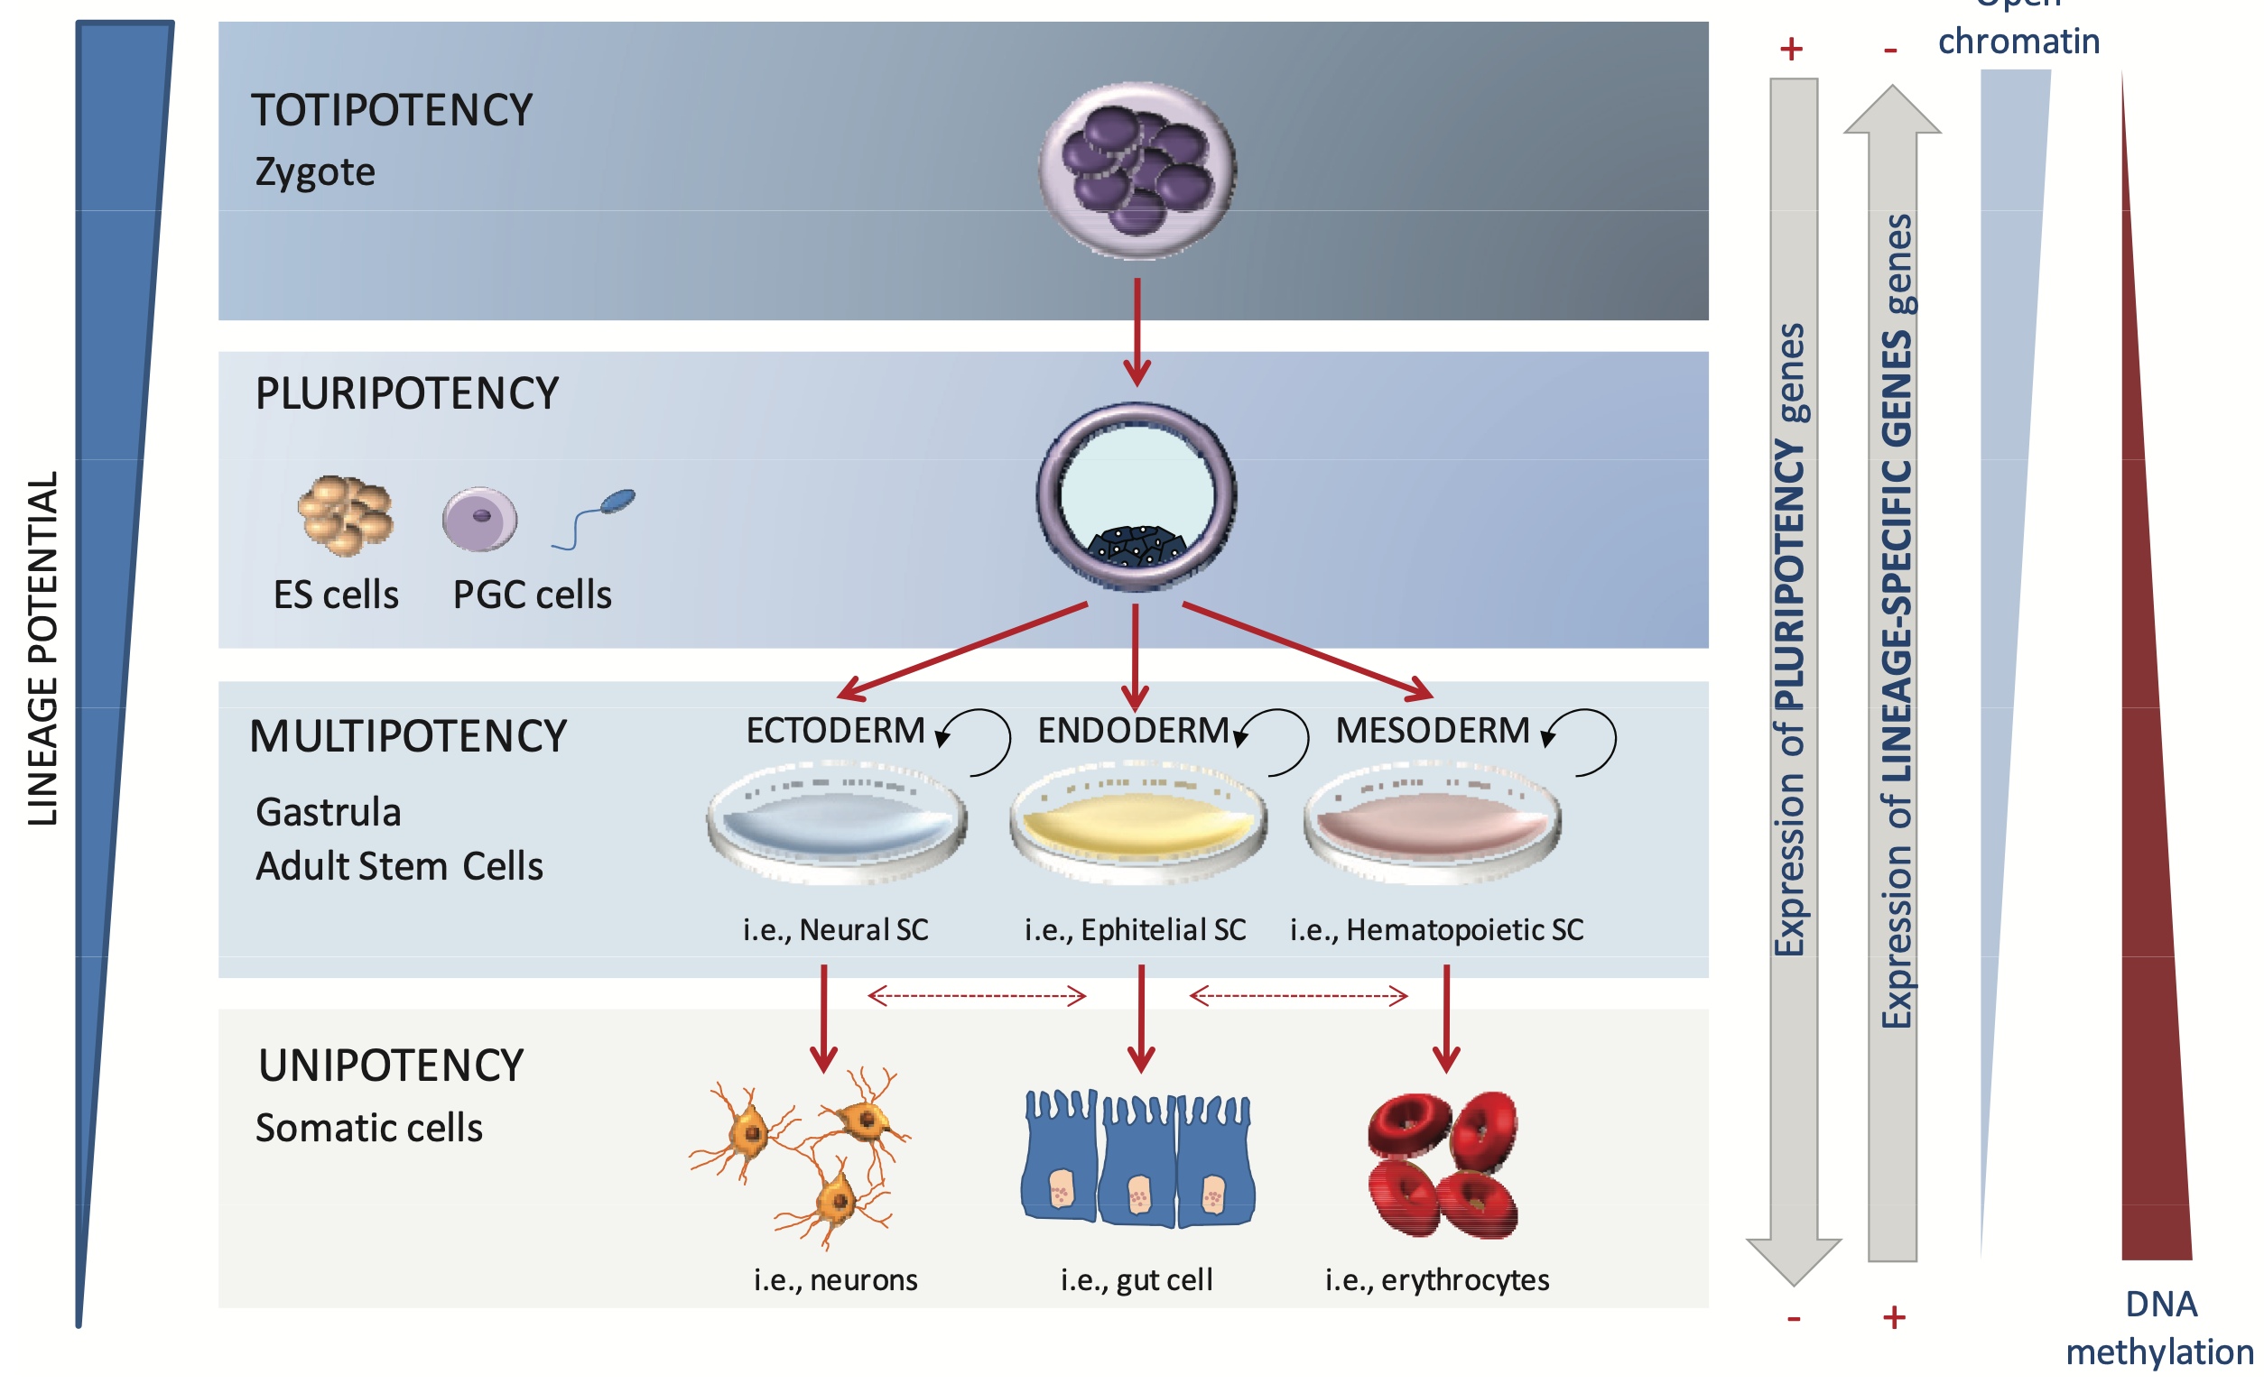
DNA Methylation Changes
During Differentiation
Berdasco, M., & Esteller, M. Stem Cell Research & Therapy, 2011

Slide 36
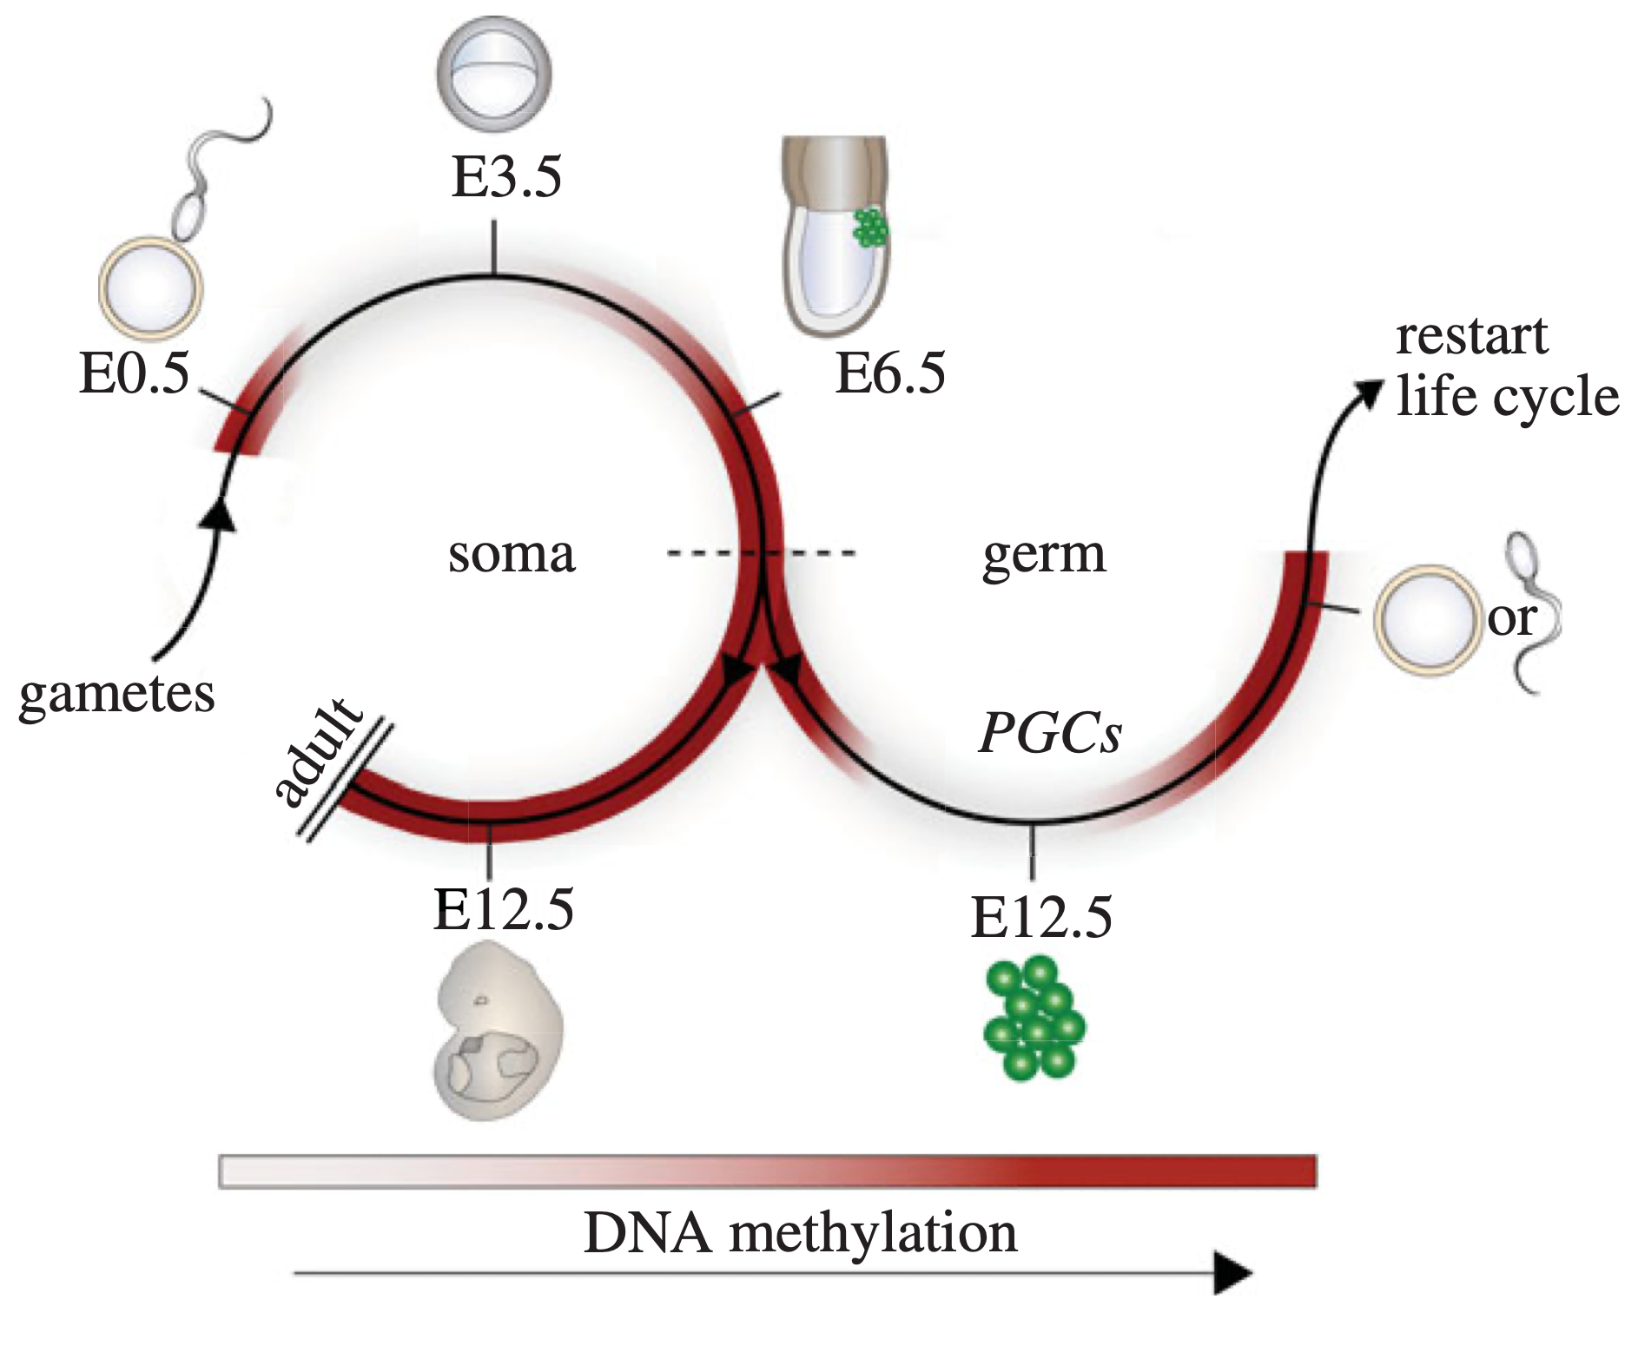
DNA Methylation Changes During Differentiation
Hackett, J. A., & Surani, M. A., Phil. Trans. R. Soc., 2012
Notes:
High-CpG density promoters (HCP) are usually hypomethylated, low CpG-density promoters (LCP) are usually methylated, and intermediate CpG-density promoters (ICP) can be either methylated or unmethylated (shown as shaded). In general, methylation only has a significant transcriptional effect at HCPs and ICPs, whereas methylation at LCPs does not correlate with repression. Note also that the absence of methylation only generates a permissive state for transcription and does not necessarily result in gene activity. Imprinted loci are methylated on one allele and hypomethylated on the other. This can have allele-specific effects by either modulating interactions between enhancers (green) and promoters (upper imprinted gene) or regulating expression of an antisense ncRNA, which silences genes in cis (lower imprinted gene). Gene bodies are generally hypermethylated, which may function to repress cryptic internal promoters. Transposable elements are usually highly methylated in the promoter and coding regions, which silences their expression and can lead to their mutation and inactivation through cytosine deamination (asterisks), respectively. A1/A2: Allele 1 and Allele 2. DMR, differentially methylated region.

Slide 37
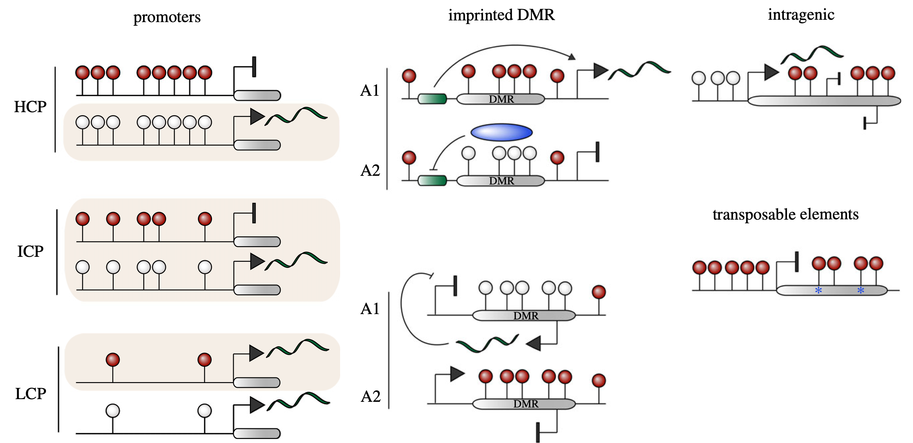
Different Roles of DNA Methylation
Hackett, J. A., & Surani, M. A., Phil. Trans. R. Soc., 2012
Notes:
High-CpG density promoters (HCP) are usually hypomethylated, low CpG-density promoters (LCP) are usually methylated, and intermediate CpG-density promoters (ICP) can be either methylated or unmethylated (shown as shaded). In general, methylation only has a significant transcriptional effect at HCPs and ICPs, whereas methylation at LCPs does not correlate with repression. Note also that the absence of methylation only generates a permissive state for transcription and does not necessarily result in gene activity. Imprinted loci are methylated on one allele and hypomethylated on the other. This can have allele-specific effects by either modulating interactions between enhancers (green) and promoters (upper imprinted gene) or regulating expression of an antisense ncRNA, which silences genes in cis (lower imprinted gene). Gene bodies are generally hypermethylated, which may function to repress cryptic internal promoters. Transposable elements are usually highly methylated in the promoter and coding regions, which silences their expression and can lead to their mutation and inactivation through cytosine deamination (asterisks), respectively. A1/A2: Allele 1 and Allele 2. DMR, differentially methylated region.

Slide 38
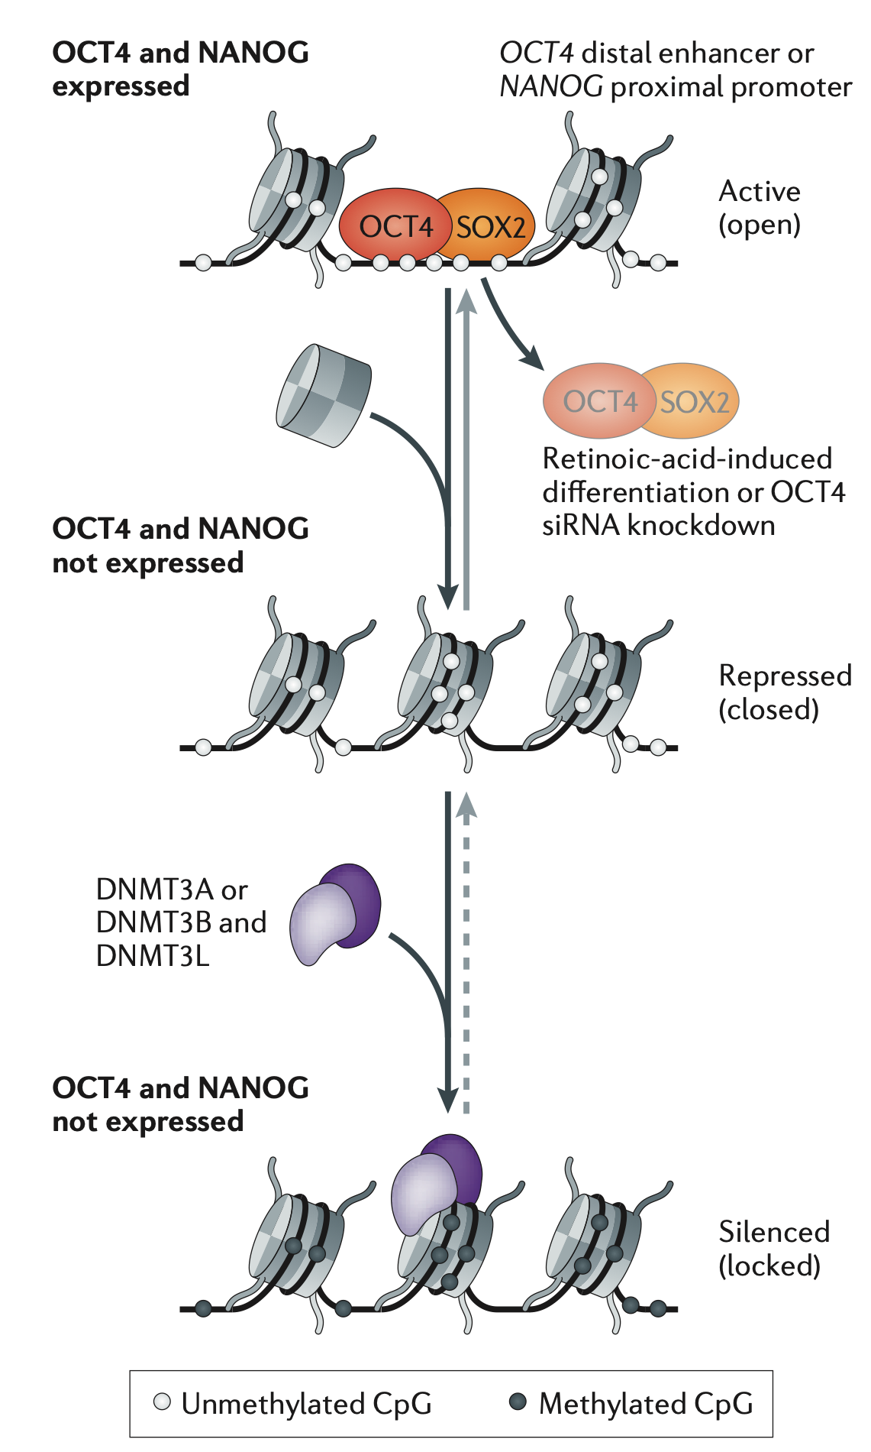
Silencing Precedes DNA Methylation
Jones, P. A. Nature Reviews Genetics (2012).

Slide 39
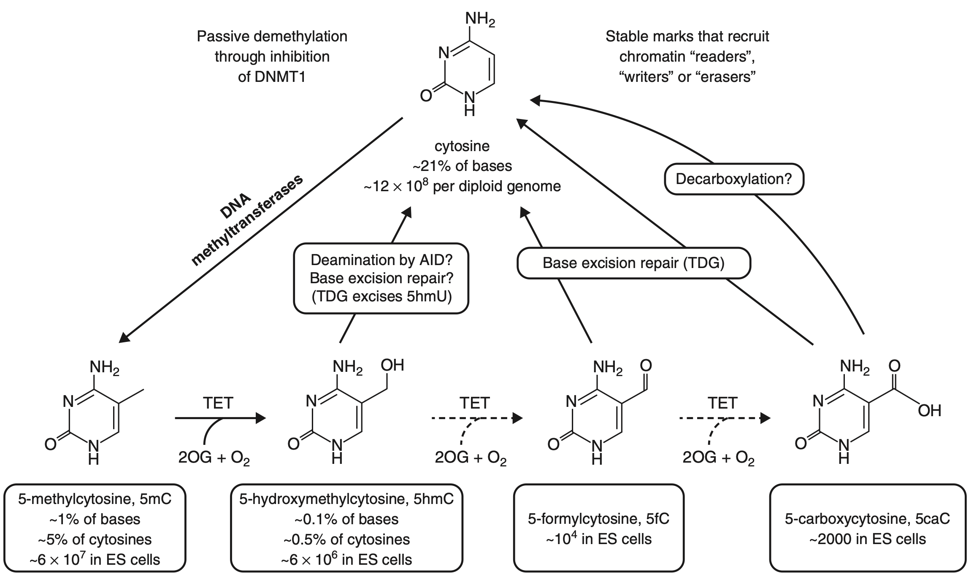
Different Forms of Methylation
Koh, K. et al. (2013). Current Opinion in Cell Biology, 25(2), 152–161.

Slide 40
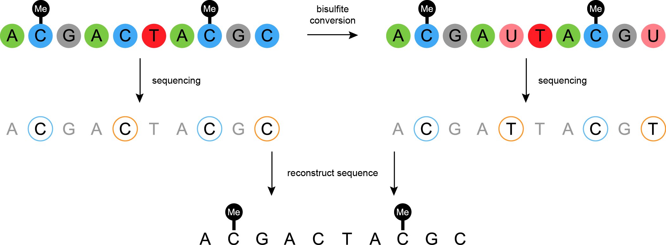
Bisulfite Sequencing
http://www.atdbio.com

Slide 41
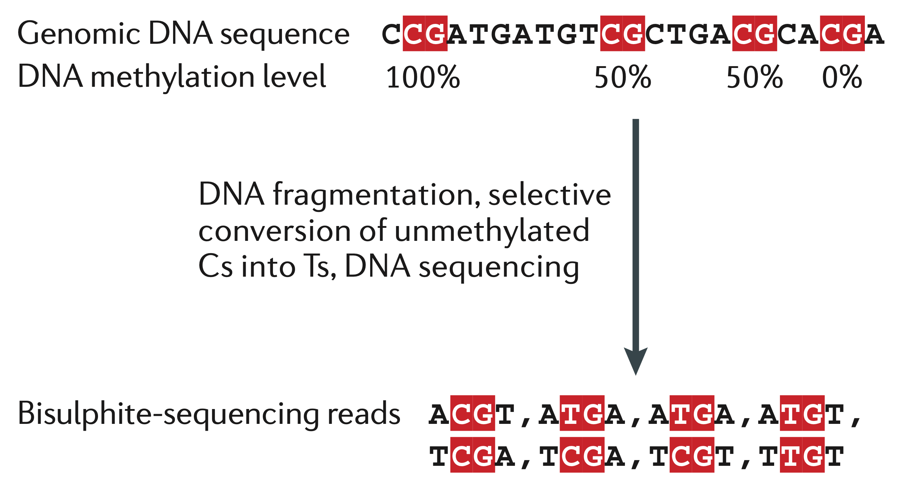
Aligning Bis-seq reads
Bock, C. (2012). Nature Reviews Genetics, 13(10), 705–719.

Slide 42
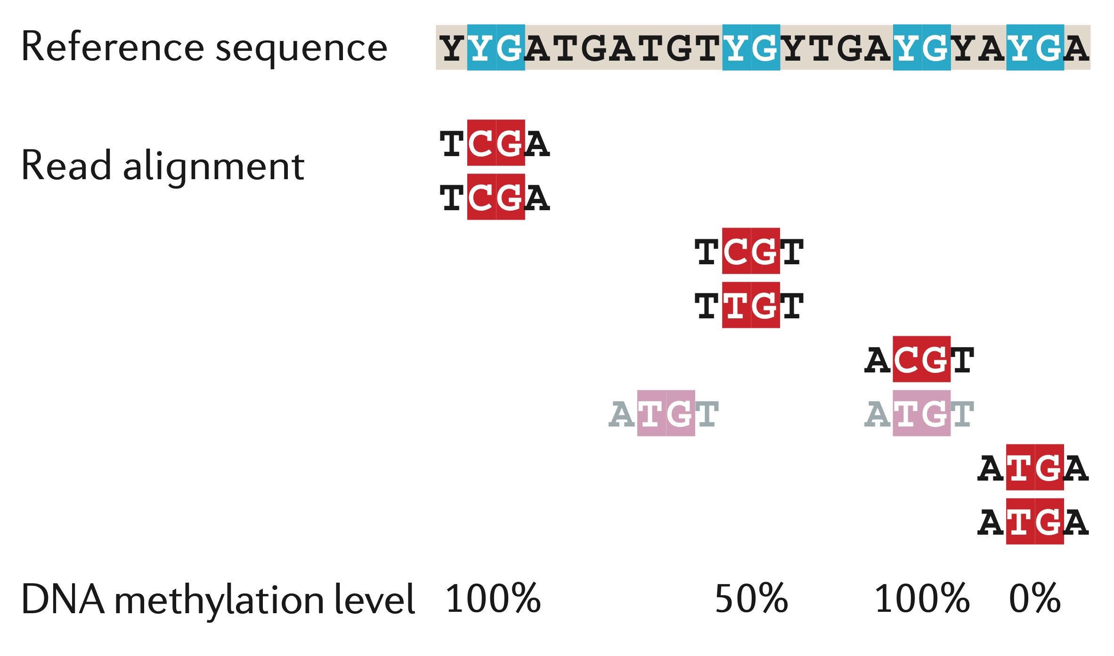
Wild-card Alignment
Bock, C. (2012). Nature Reviews Genetics, 13(10), 705–719.

Slide 43
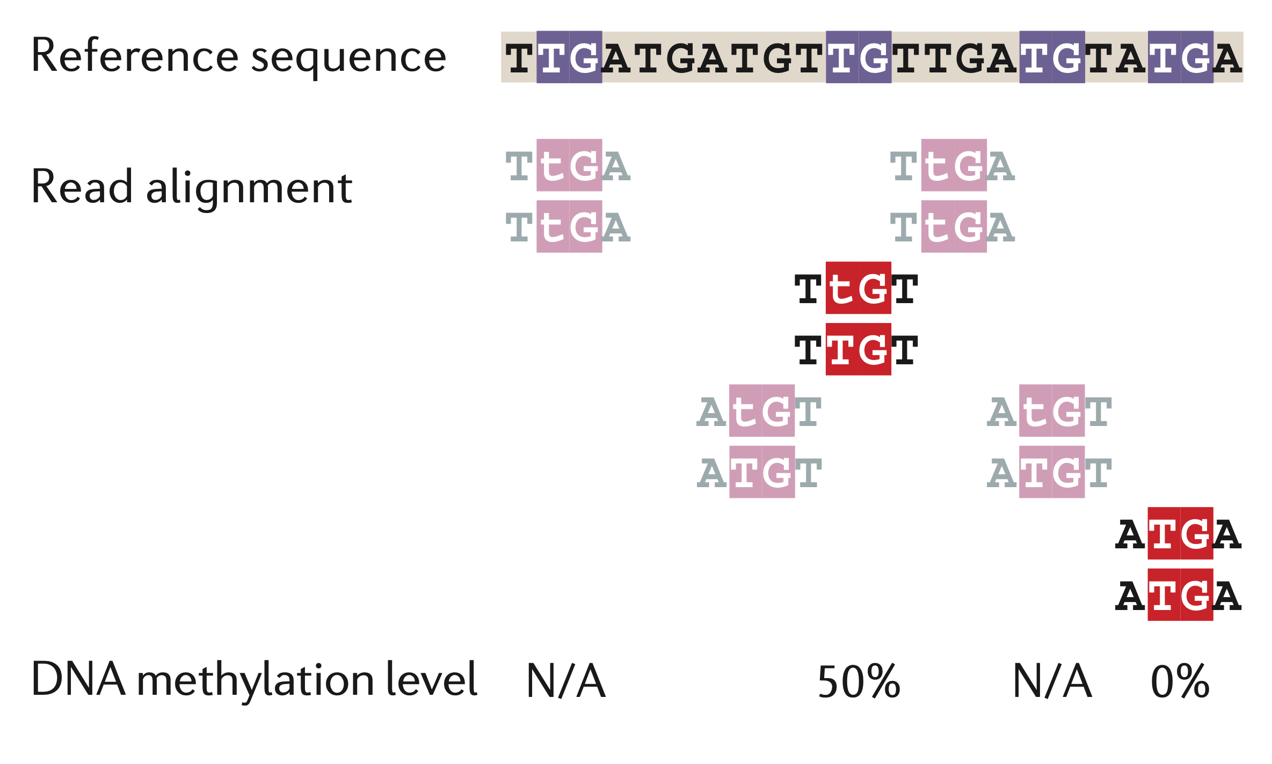
Three-letter Alignment
Bock, C. (2012). Nature Reviews Genetics, 13(10), 705–719.

